Slide 1
Command Line Arguments

Slide 2
Command Line Arguments
The java command-line argument is an argument i.e. passed at the time of running the java program.
The arguments passed from the console can be received in the java program and it can be used as an input.
So, it provides a convenient way to check the behavior of the program for the different values. You can pass N (1,2,3 and so on) numbers of arguments from the command prompt.

Slide 3
Example
class CommandLineExample{
public static void main(String args[]){
System.out.println("Your first argument is: "+args[0]);
}
}
compile by > javac CommandLineExample.java
run by > java CommandLineExample MangaRao

Slide 4
Example of command-line argument that prints all the values
class A{
public static void main(String args[]){
for(int i=0;i<args.length;i++)
System.out.println(args[i]);
}
}
compile by > javac A.java
run by > java A MangaRao HYD KPY 500018

Slide 5
Passing Command Line Arguments Using IDE (Eclipse)
Go to Debug Configuration
Select the Program Arguments selection
Input the values
Apply Changes
Run/Debug the Program

Slide 6
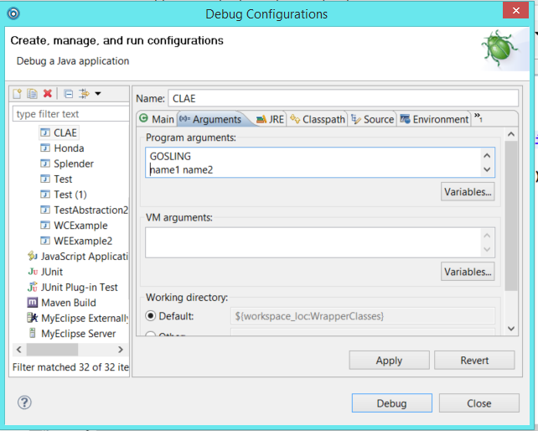

Slide 7
Program to find addition of two given numbers from command prompt
public class Add{
public static void main(String[] args) {
double num1 = Double.parseDouble(args[0]);
double num2 = Double.parseDouble(args[1]);
System.out.println("Additon of two numbers : "+(num1+num2));
}
}

